Slide 1
Course Introduction
by wwy

Slide 2
TAs & Me
SAs
邱逸伦12013006@mail.sustech.edu.cn
牛景萱12010641@mail.sustech.edu.cn
戴郭轶12011211@mail.sustech.edu.cn
You can send message to SAs by Email or ask for contact privately.
Lab Teacher 王维语
wangwy@mail.sustech.edu.cn
Office 110, South Tower, CoE
Office Hour: Thur 9:00~11:00

Slide 3
Course Intro
Homework：
35% maybe
（OJ & Sakai. Pdf is only welcom format submitted on sakai）
Project：
15% maybe
Final Exam：
40%
Attendance：10%
DO NOT PLAGIARIZE

Slide 4
Lab Syllabus
1. Software Installing
2. Constraint & DML
3. Simple Query
4. Complex Query I
5. Complex Query II
6. Database Design
7. Database and File
8. Combining Queries
9. Window Function
10. Function
11. Trigger
12. Transaction
13. Index
14. Connectiong Pool
15. Information schema and PG Catalog
16. Project Presentation

Slide 5
Softwares Installation
CS213
by wwy

Slide 6
PostgreSQL
DataGrip

Slide 7
What is Postgres
ORDBMS
Object-relational
database
management system

Slide 8
Postgres(SQL)
SQL
Structured Query Language
https://www.postgresql.org/docs/13/sql.html

Slide 9
Why choose Postgres
The World's Most Advanced Open Source Relational Database
Free
Stability
Widely used

Slide 10
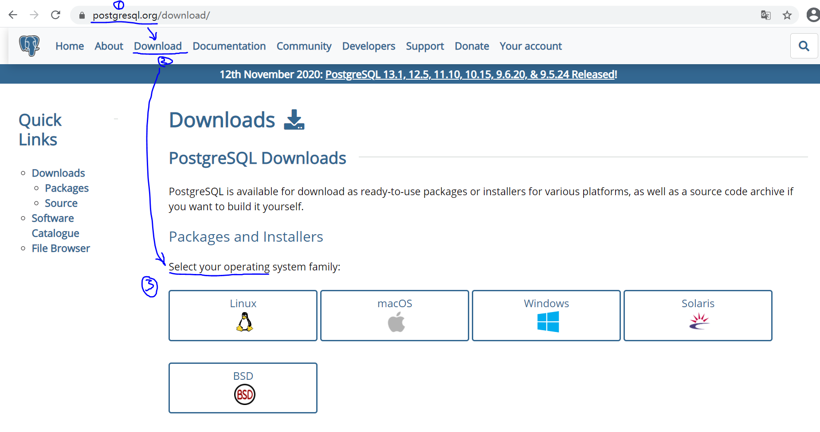
How to download Postgres
https://www.postgresql.org/

Slide 11
How to install Postgres
Install on Windows
Install on Linux
Install on Mac
Tutorial by Zhu Yueming

Slide 12
Why DataGrip
Cross-Platform
JetBrain:https://www.jetbrains.com/zh-cn/community/education/#students
Copyright
Intergreated Development Environment

Slide 13
How to download&install DataGrip
Refer to DataGrip Official Web
Read System requirment and Installation Instructions first

Slide 14
How to use DataGrip
Brief direction in Part IV of Tutorial by Zhu Yueming

Slide 15
Conection Modes
client
client
IDE
Program
DBMS
IP
Port
User
Password
Database
Driver
client
service
Script

Slide 16
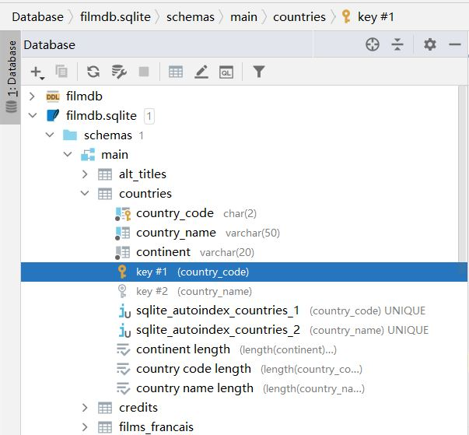
Postgres Structure
Database
Schema
View
Tables
Datas
Logic

